Slide 1
STUDENT VIOLATION SYSTEM

Slide 2
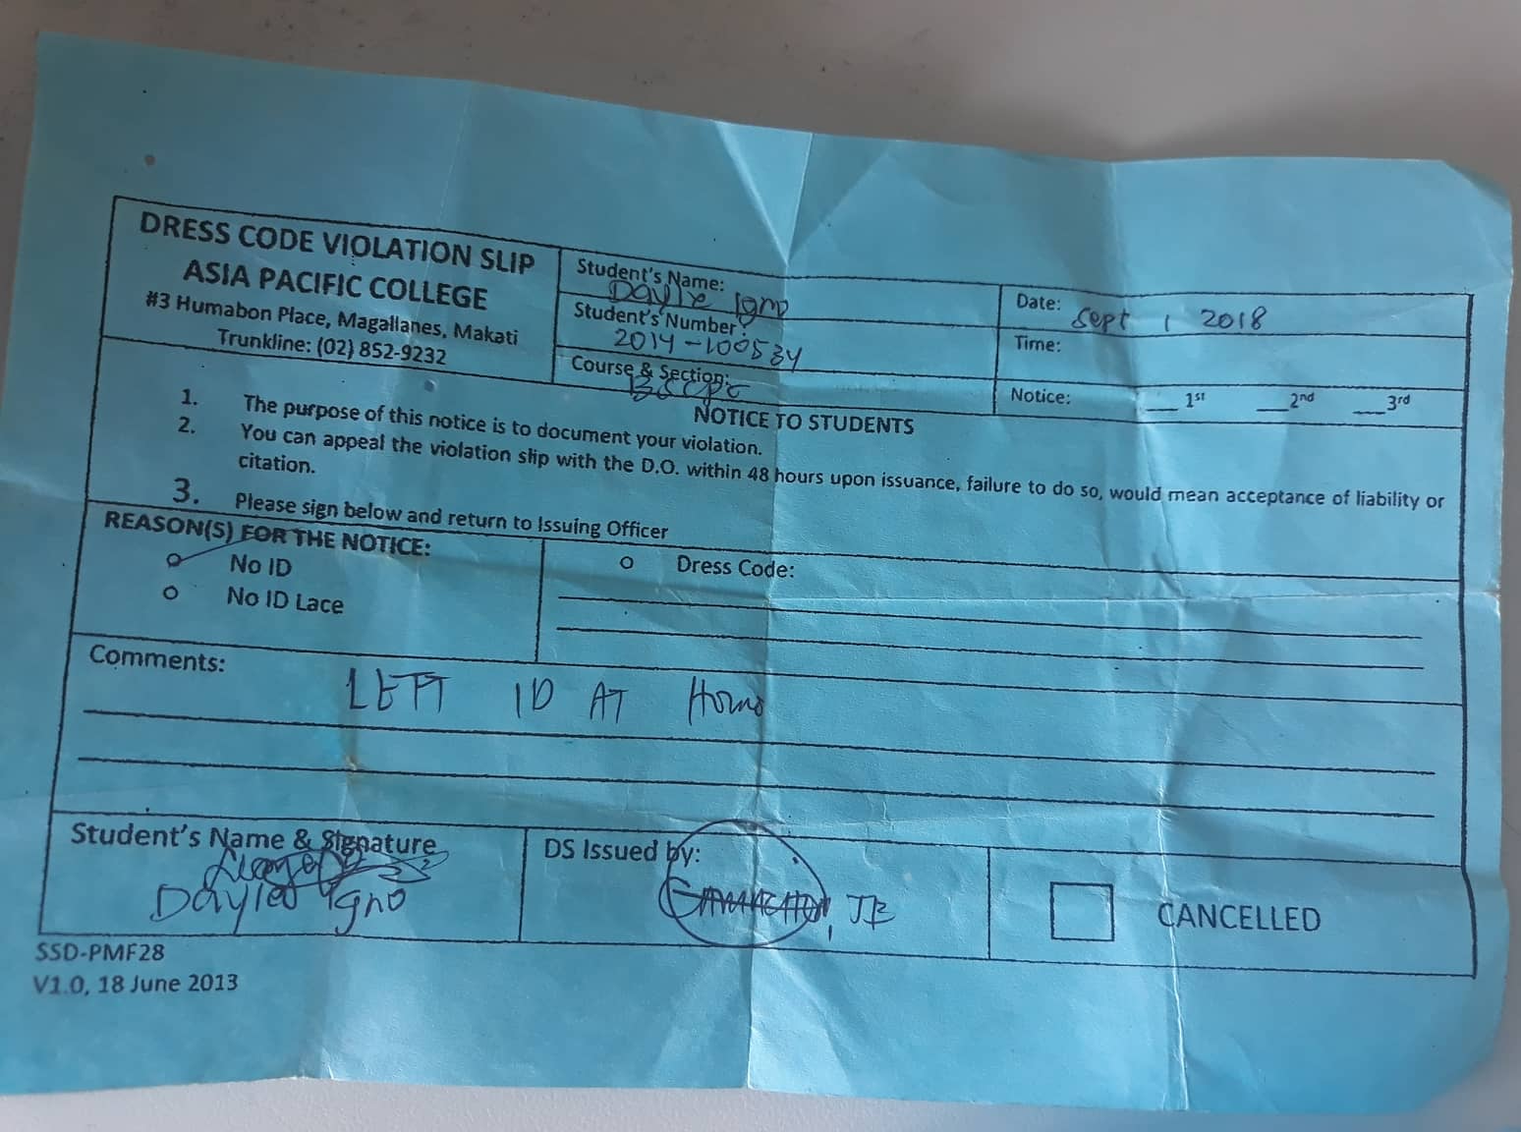
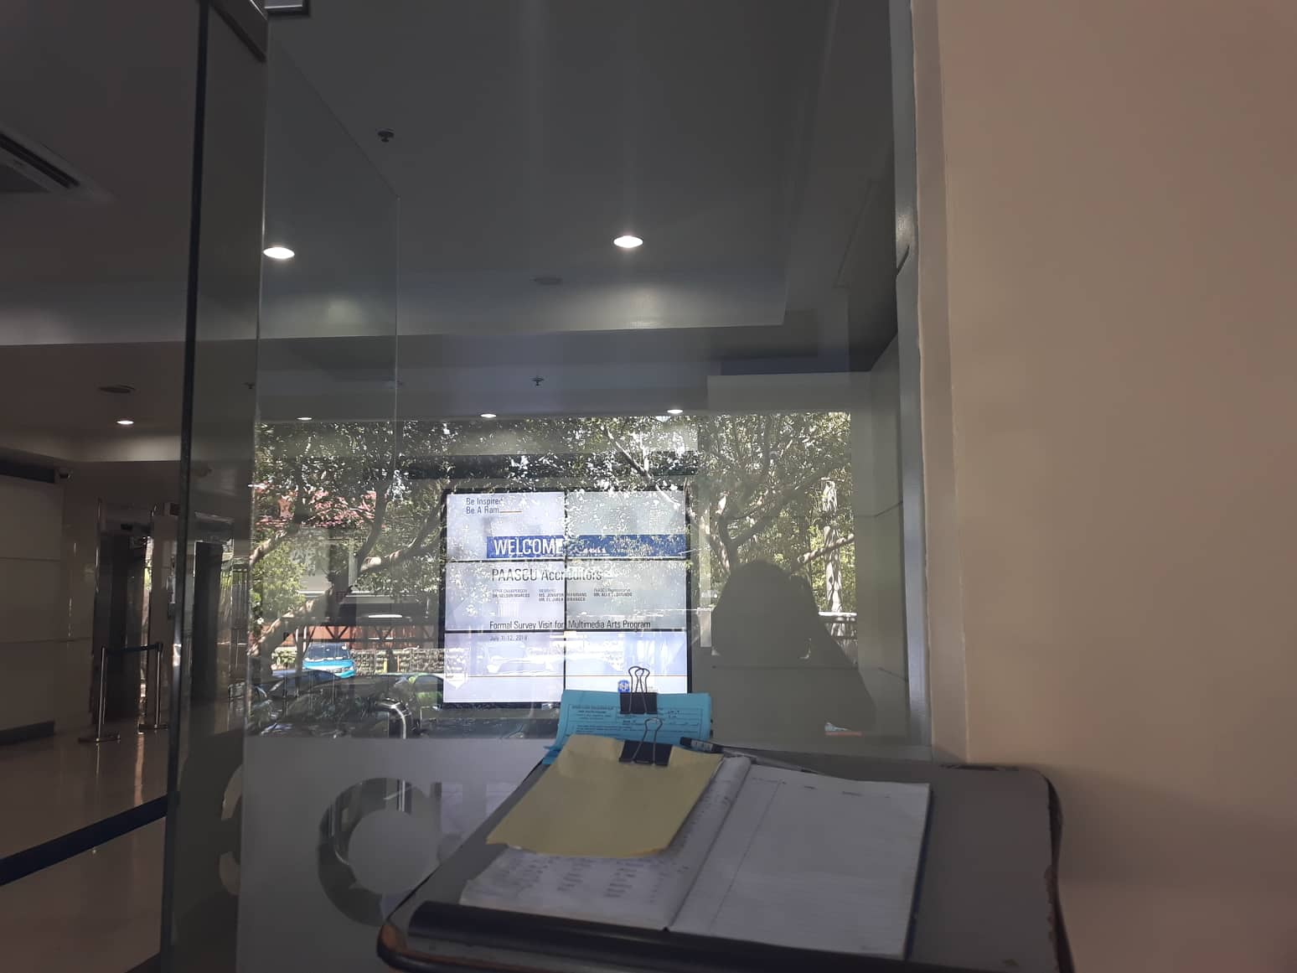
EXISTING VIOLATIONS:

Slide 3
USER NEEDS:
Guards needs a way to issue violations faster.
Guards needs to be able to check student credentials faster.
Guards needs a way to issue violations without using paper.
Guards needs a way to issue violations in legible form.
Students needs a way to monitor their violations.
Discipline Office needs a way to monitor student violations easily.
Discipline’s Office needs a way to cancel violations without searching for violation paper issued.

Slide 4
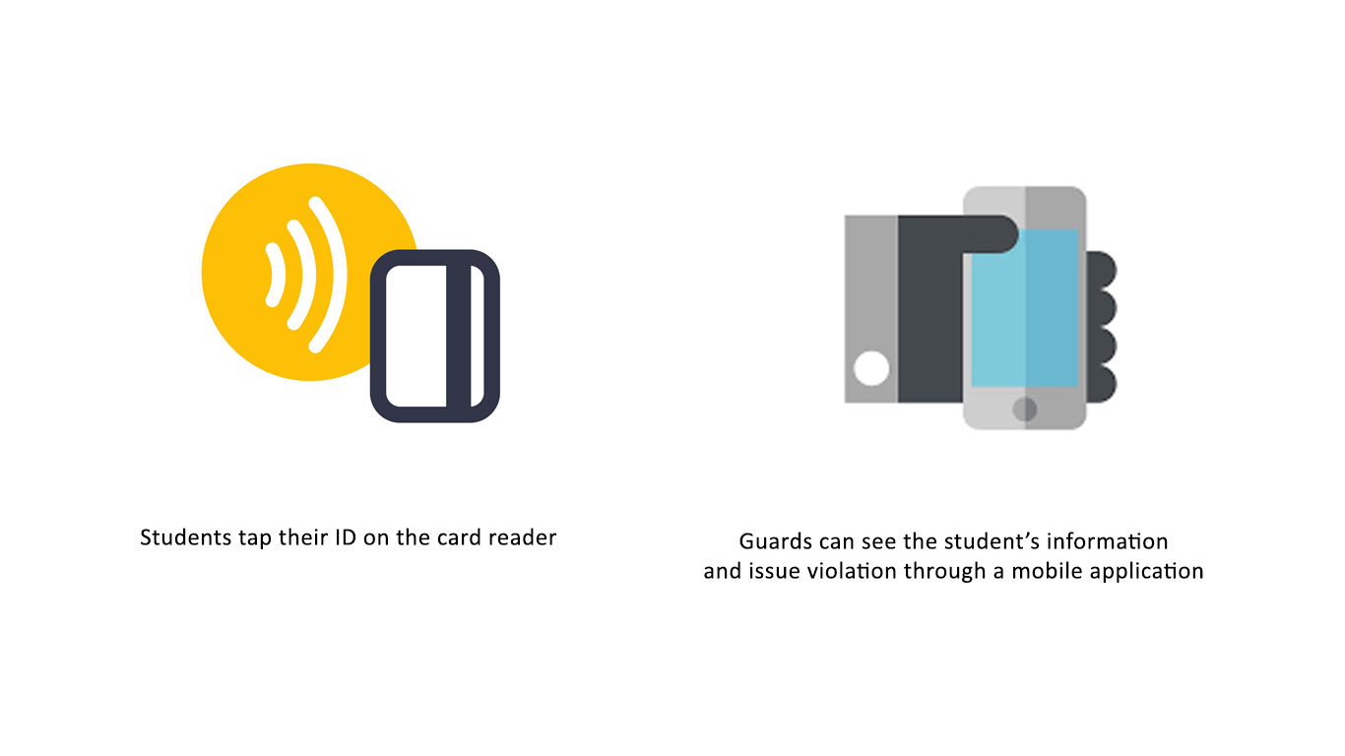
SOLUTION:

Slide 5
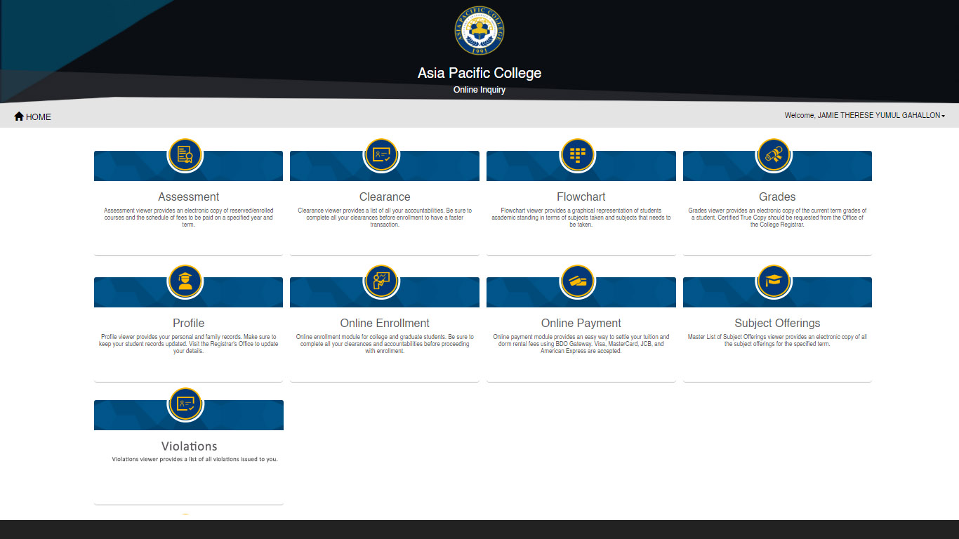
SOLUTION:

Slide 6
POINT OF VIEW
An electronic violation system can minimize issuing time, allow transparency and ease of access for all users.

